Slide 1
Unraveling the Complexity of MAPK Signaling Pathway
Ines Schneider
Loghman Samani
University of Stuttgart
January 2024

Slide 2
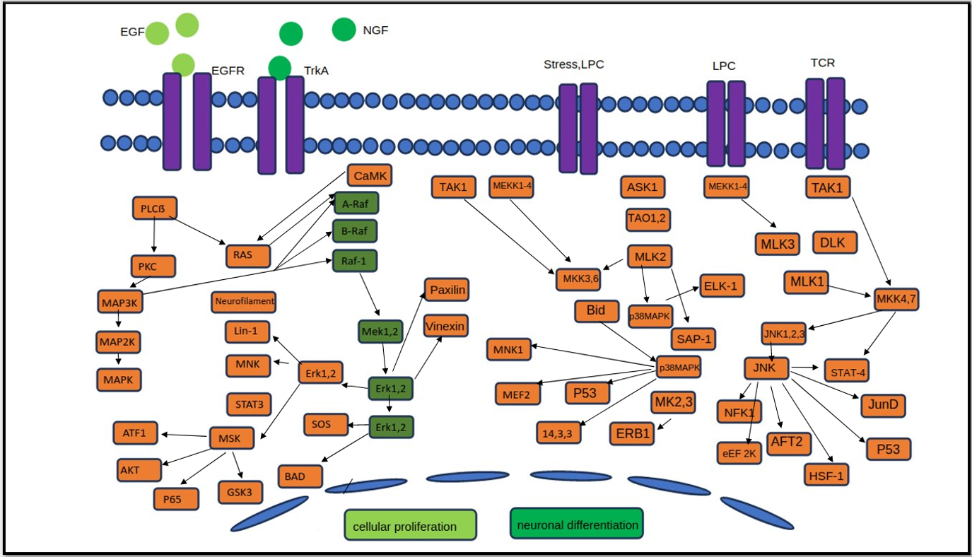
MAP Kinase Pathways

Slide 3
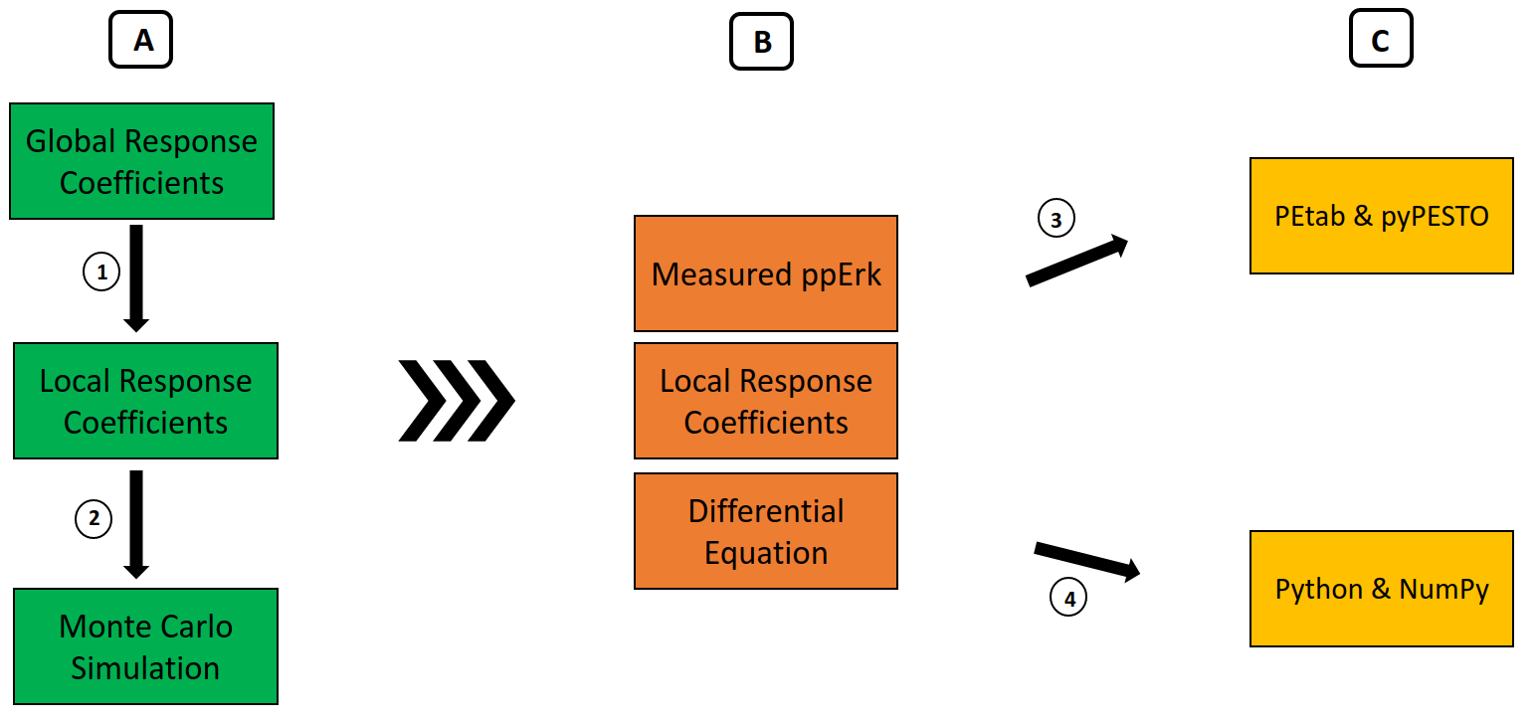
Project Overview

Slide 4

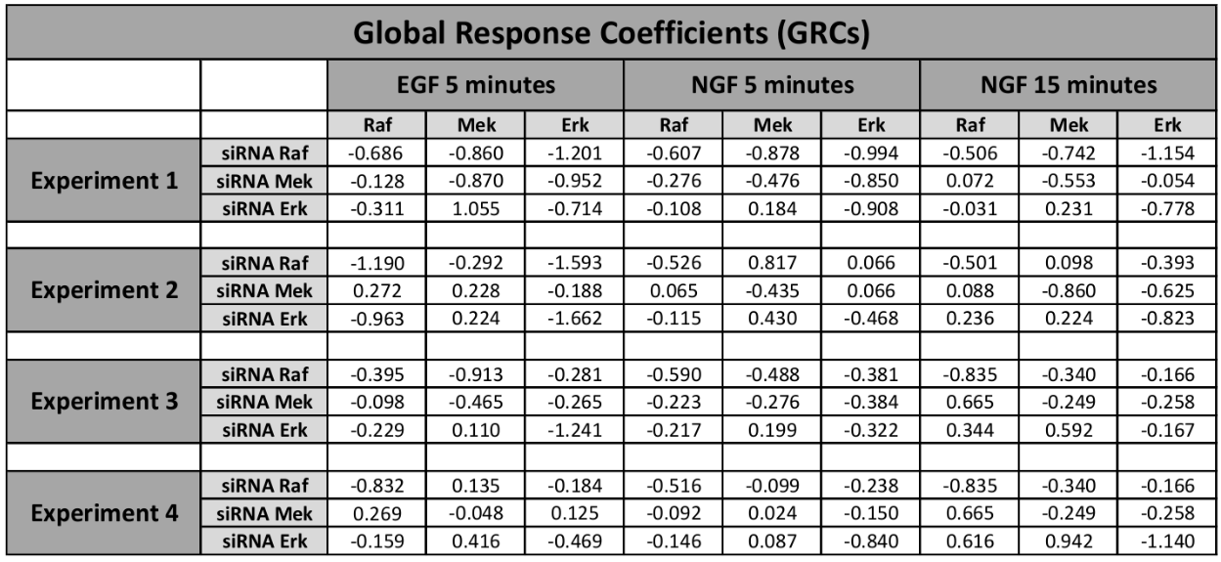
Calculate the Local Response Coefficients from the Global Response Coefficients using Modular Response Analysis

Slide 5
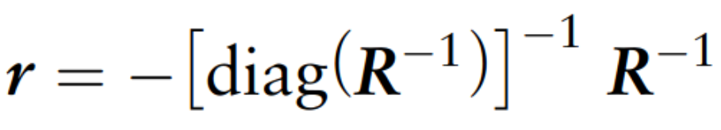
Calculate the Local Response Coefficients from the Global Response Coefficients using Modular Response Analysis

Slide 6
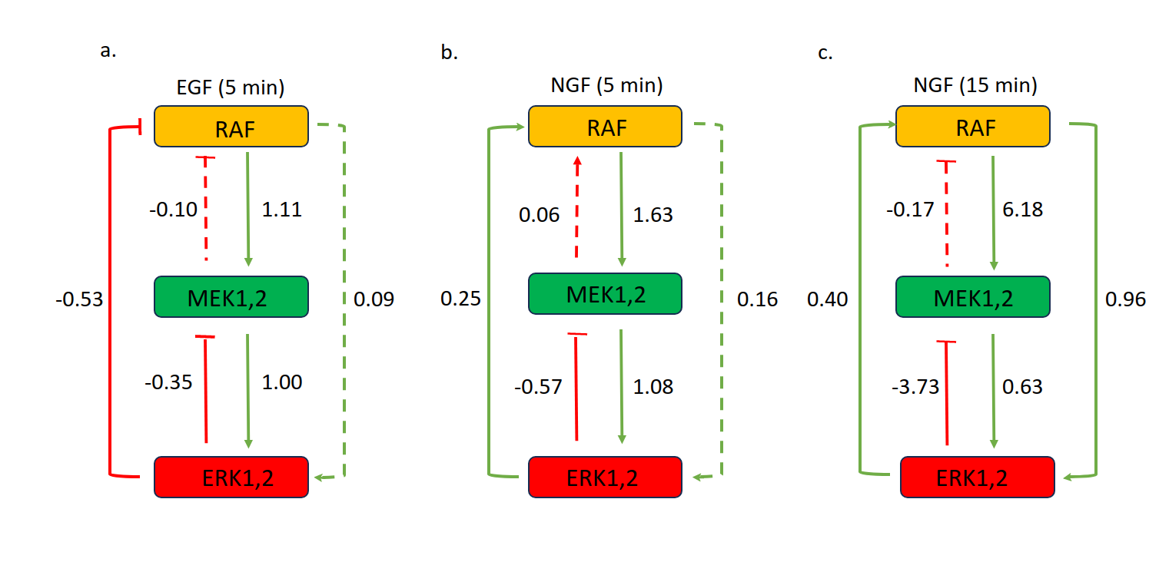
Calculate the Local Response Coefficients from the Global Response Coefficients using Modular Response Analysis

Slide 7
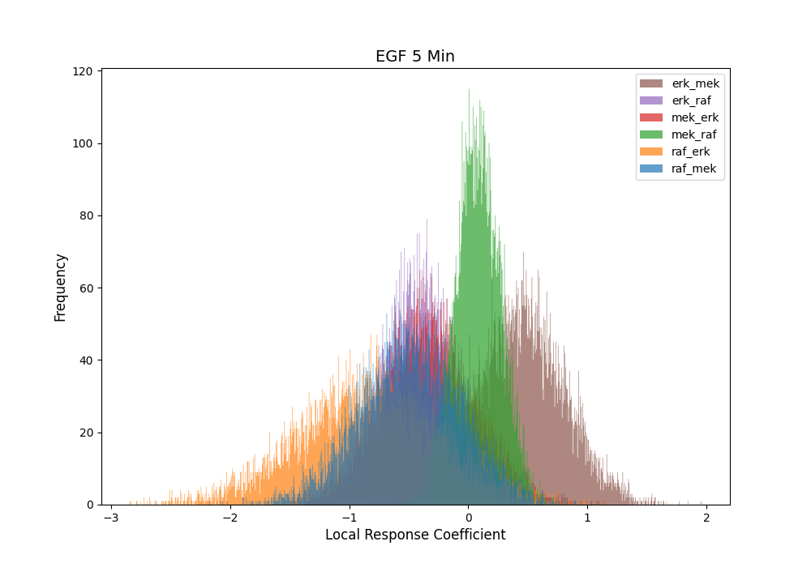
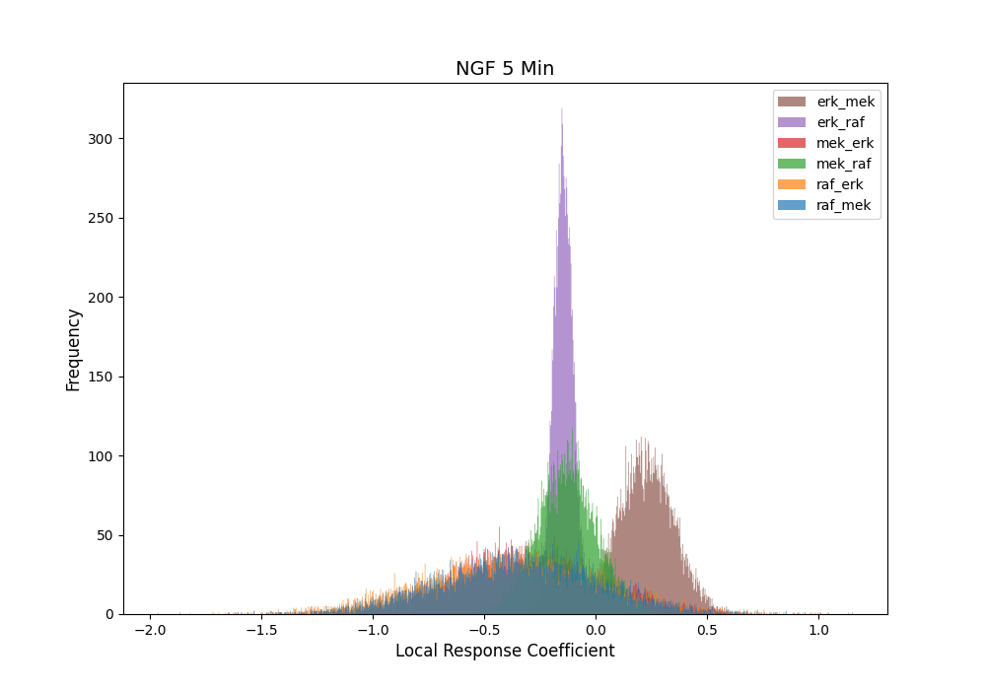
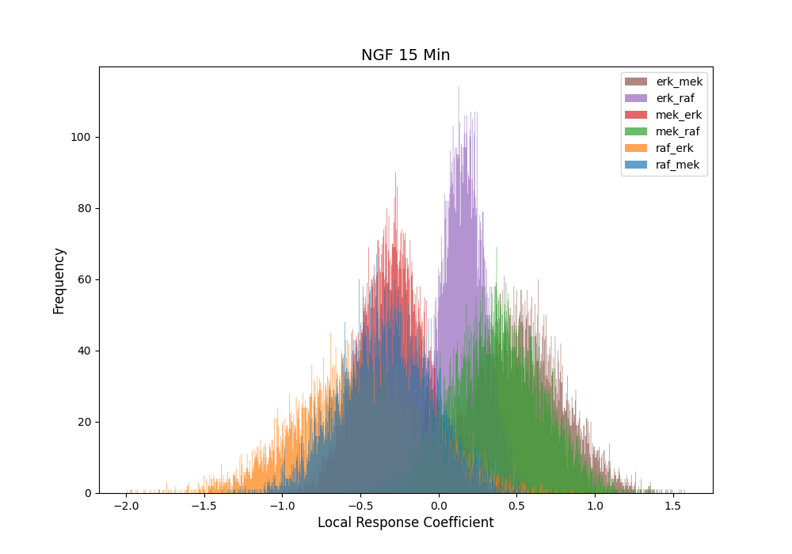
Calculate the Local Response Coefficients from the Global Response Coefficients using Modular Response Analysis
Conducting Monte Carlo Simulations

Slide 8
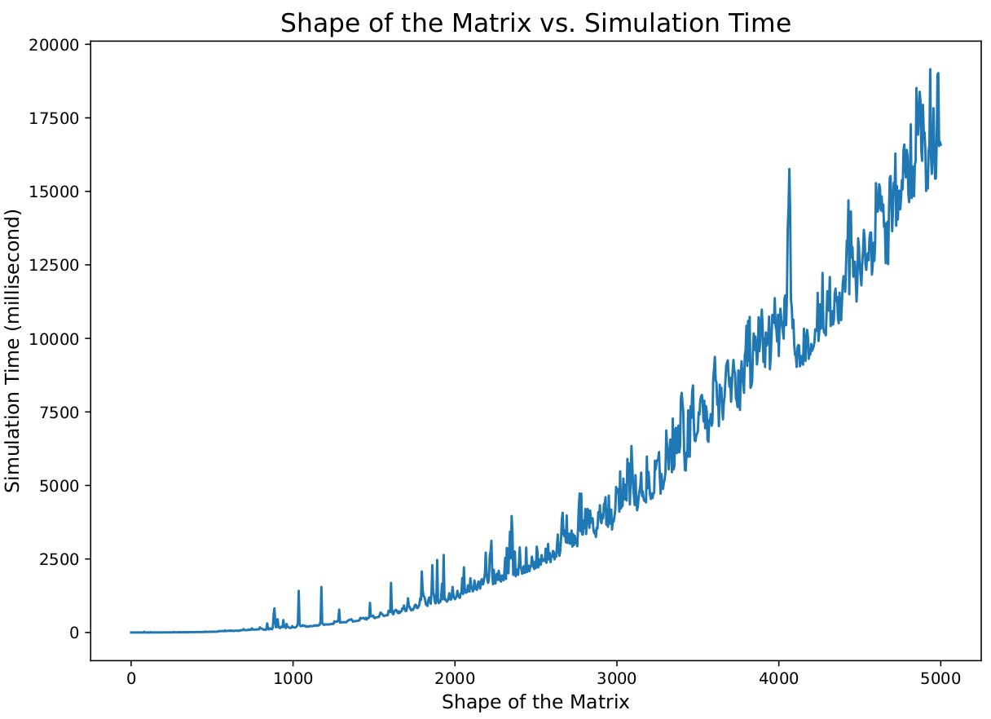
Calculate the Local Response Coefficients from the Global Response Coefficients using Modular Response Analysis
Conducting Monte Carlo Simulations
Calculation Intensity

Slide 9
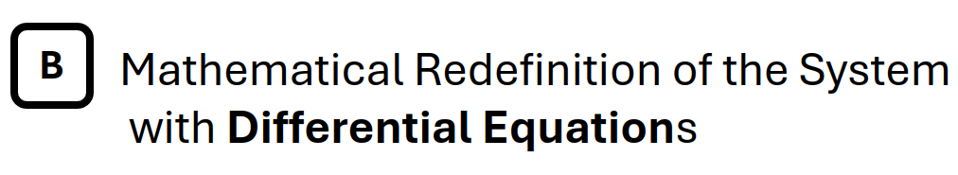
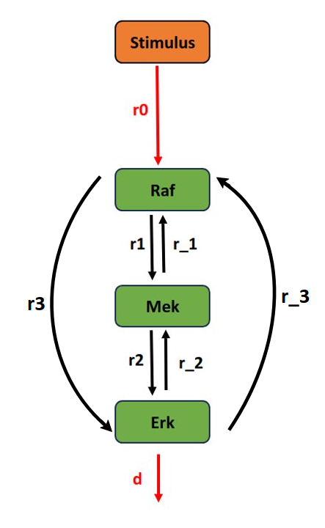
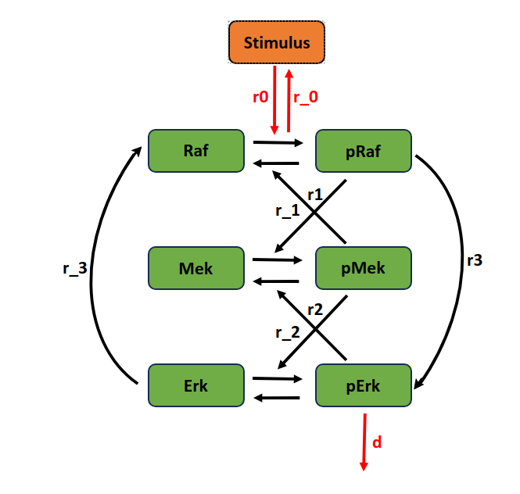

Slide 10

Estimating unknown parameters with Petab & Pypesto
- Using Pandas DataFrame to store reaction information
- Creating petab tables from pandas tables
- Using petab tables to define the pypesto problem and estimate the parameters
Estimating unknown parameters with Python & NumPy
- Using gradient descent algorithm

Slide 11
Callenges
Insufficient information about the system's topology and structure
Network complexity
Undefined membrane proteins (EGFR and TrkA)
Computational limitations

Slide 12
References
[1] https://github.com/LoqmanSamani/mapk_pathway
[2] Santos, S., Verveer, P. & Bastiaens, P. Growth factor-induced MAPK network topology
shapes Erk response determining PC-12 cell fate. Nat Cell Biol 9, 324–330 (2007).
[3] Seger, Rony, and Edwin G. Krebs. "The MAPK signaling cascade." The FASEB journal 9.9
(1995): 726-735.
[4] Kim EK, Choi EJ. Compromised MAPK signaling in human diseases: an update. Arch
Toxicol. 2015 Jun;89(6):867-82. doi: 10.1007/s00204-015-1472-2. Epub 2015 Feb 18. PMID:
25690731.
[5] Greene, L. A. & Tischler, A. S. Establishment of a noradrenergic clonal line of
ratadrenalpheochromocytoma cells which respond to nerve growth factor. Proc. Natl Acad.
Sci.USA 73, 2424–2428 (1976).
[6] Specificity of Receptor Tyrosine Kinase Signaling: Transient versus Sustained
ExtracellularSignal-Regulated Kinase Activation, C. J. Marshall. Cell, Vol, 80, 179-185,
January27, 1995, Copyright© 1995by Cell Press. [Cell] Accessed 15 November 2023
[7] Kholodenko, B. N. et al. Untangling the wires: a strategy to trace functional interactions in
signaling and gene networks. Proc. Natl Acad. Sci. USA 99, 12841–12846 (2002).
[8] Schmiester L, Schälte Y, Bergmann FT, Camba T, Dudkin E, Egert J, et al. (2021) PEtab—
Interoperable specification of parameter estimation problems in systems biology. PLoS Comput
Biol 17(1): e1008646.
[9] Leonard Schmiester, Daniel Weindl, Jan Hasenauer, Efficient gradient-based parameter
estimation for dynamic models using qualitative data, Bioinformatics, Volume 37, Issue 23,
December 2021, Pages 4493–4500.
[10] Lillacci G, Khammash M (2010) Parameter Estimation and Model Selection in
Computational Biology. PLoS Comput Biol 6(3): e1000696.
[11] https://numpy.org/
[12] https://pandas.pydata.org/

Slide 13
Thank you for your time

